Slide 1



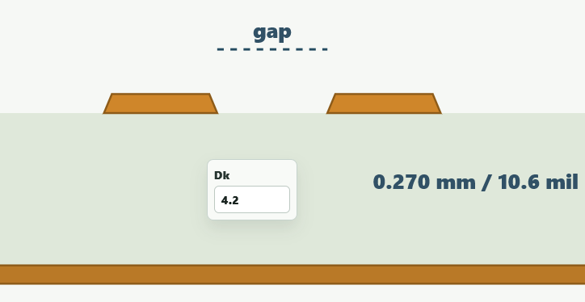



Target:
Single-ended
Differential
90
ohms
Cross Section:
Track:
Gap:
Signal:
mm
0.270
0.270
Dielectric:
mil
10.6
10.6
Dk:
mm
0.270
mil
10.6
Plane:

